Slide 1

Home
Three Commercial Shorts
By: Kristel Underhill

Slide 2

Commerical Short 1 - "Ribs"
Someone getting hit or tackled by opposing football player or friend, saying "not those ribs!"

Slide 3
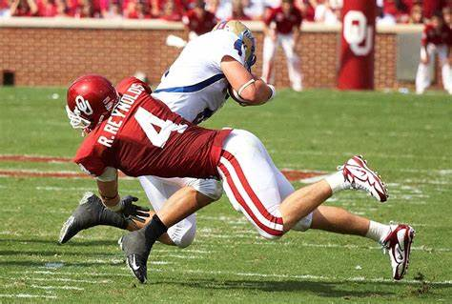

Slide 4
Commerical Short 1 - "Ribs" (con't)
Voiceover-"Not those ribs, these ribs!"

Slide 5
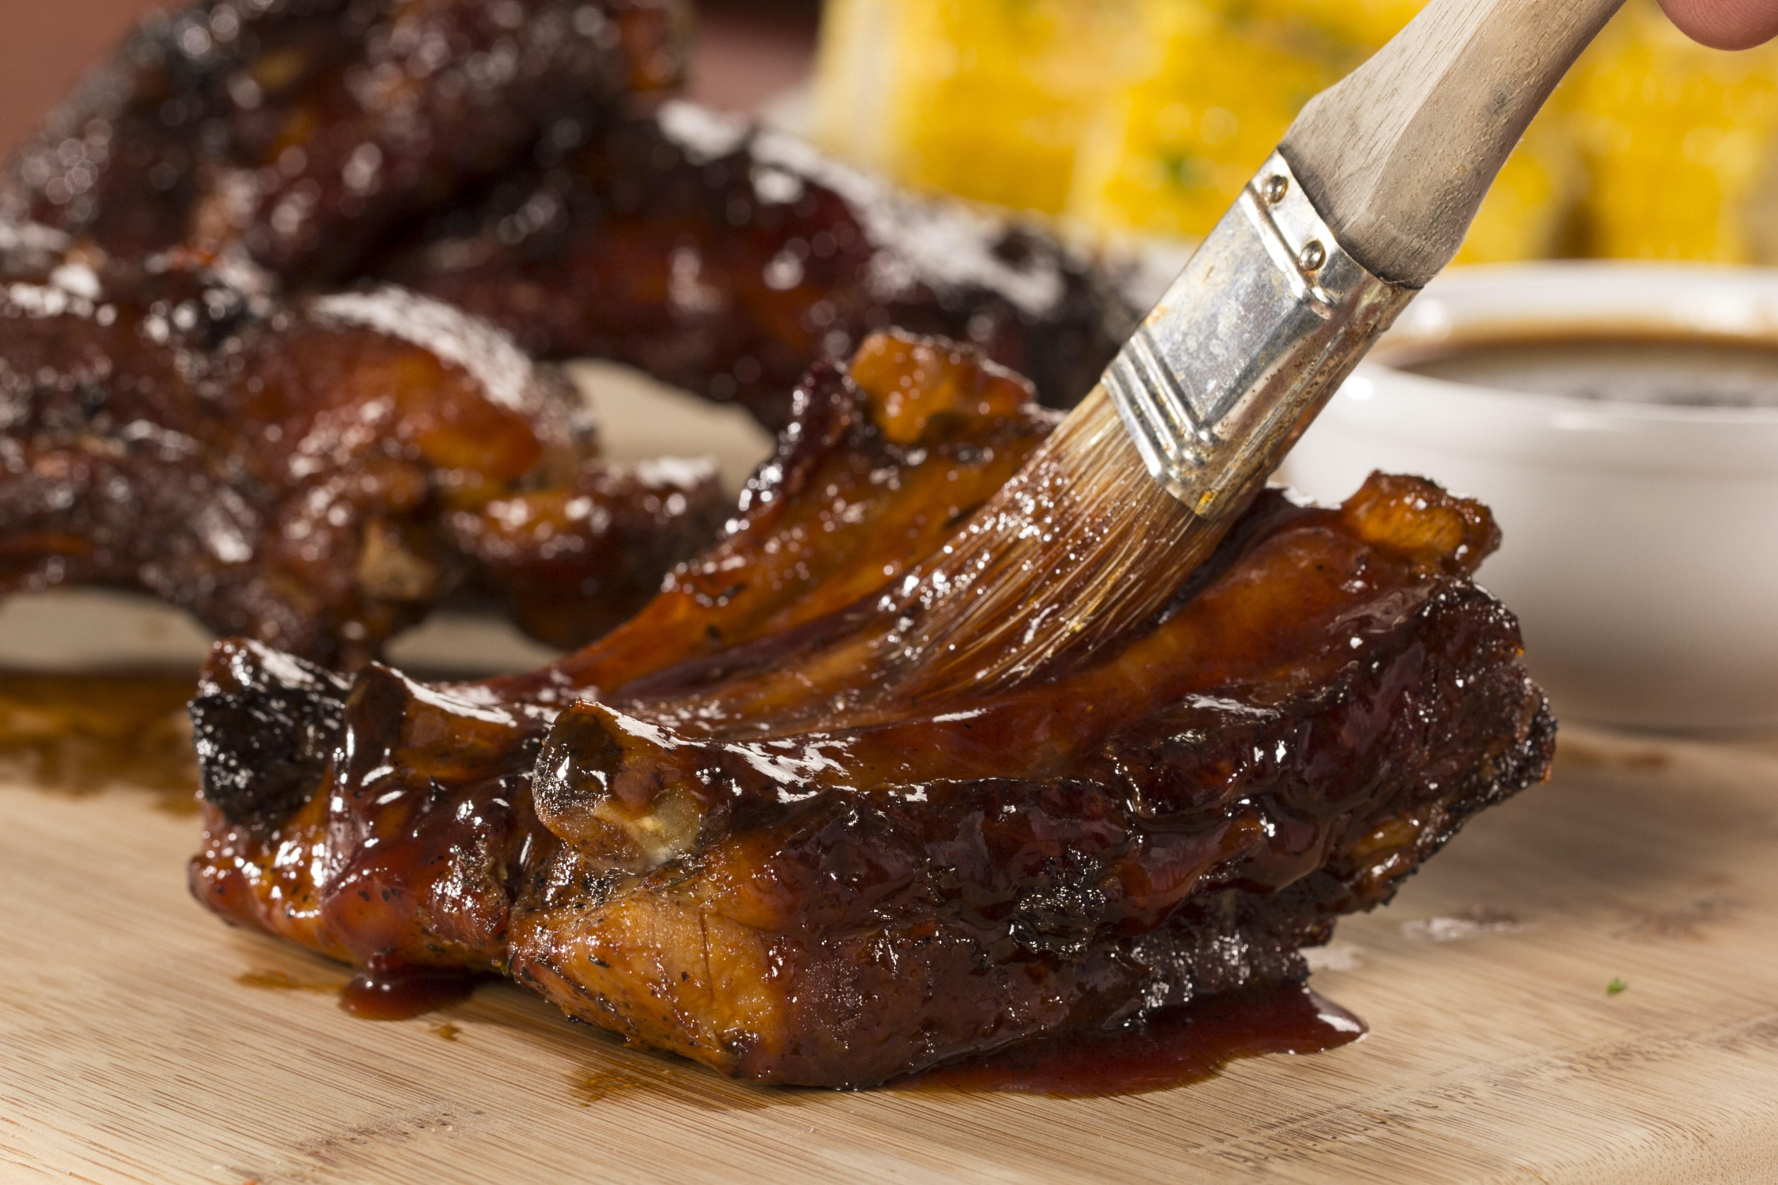

Slide 6
Commerical Short 1 - "Ribs" (con't)
(Insert shot of him happily eating the ribs injured at the end)

Slide 7


Slide 8
Commercial Short 1- "Ribs" (con't)
Insert catchy rib advertising name "Joe's smokehouse"

Slide 9
Commercial Short 2- Baseball
While baseball is generally something I consider nostalgic, to promote my creativity, and possible future in advertising- I wanted to go off the cuff for this specific project and commercial short

Slide 10
Commercial Two- Baseball (con't)
This specific short will have a more "sexy" appeal
Insert woman voiceover with a sexy voice
Think ketchup dripping on hotdog

Slide 11
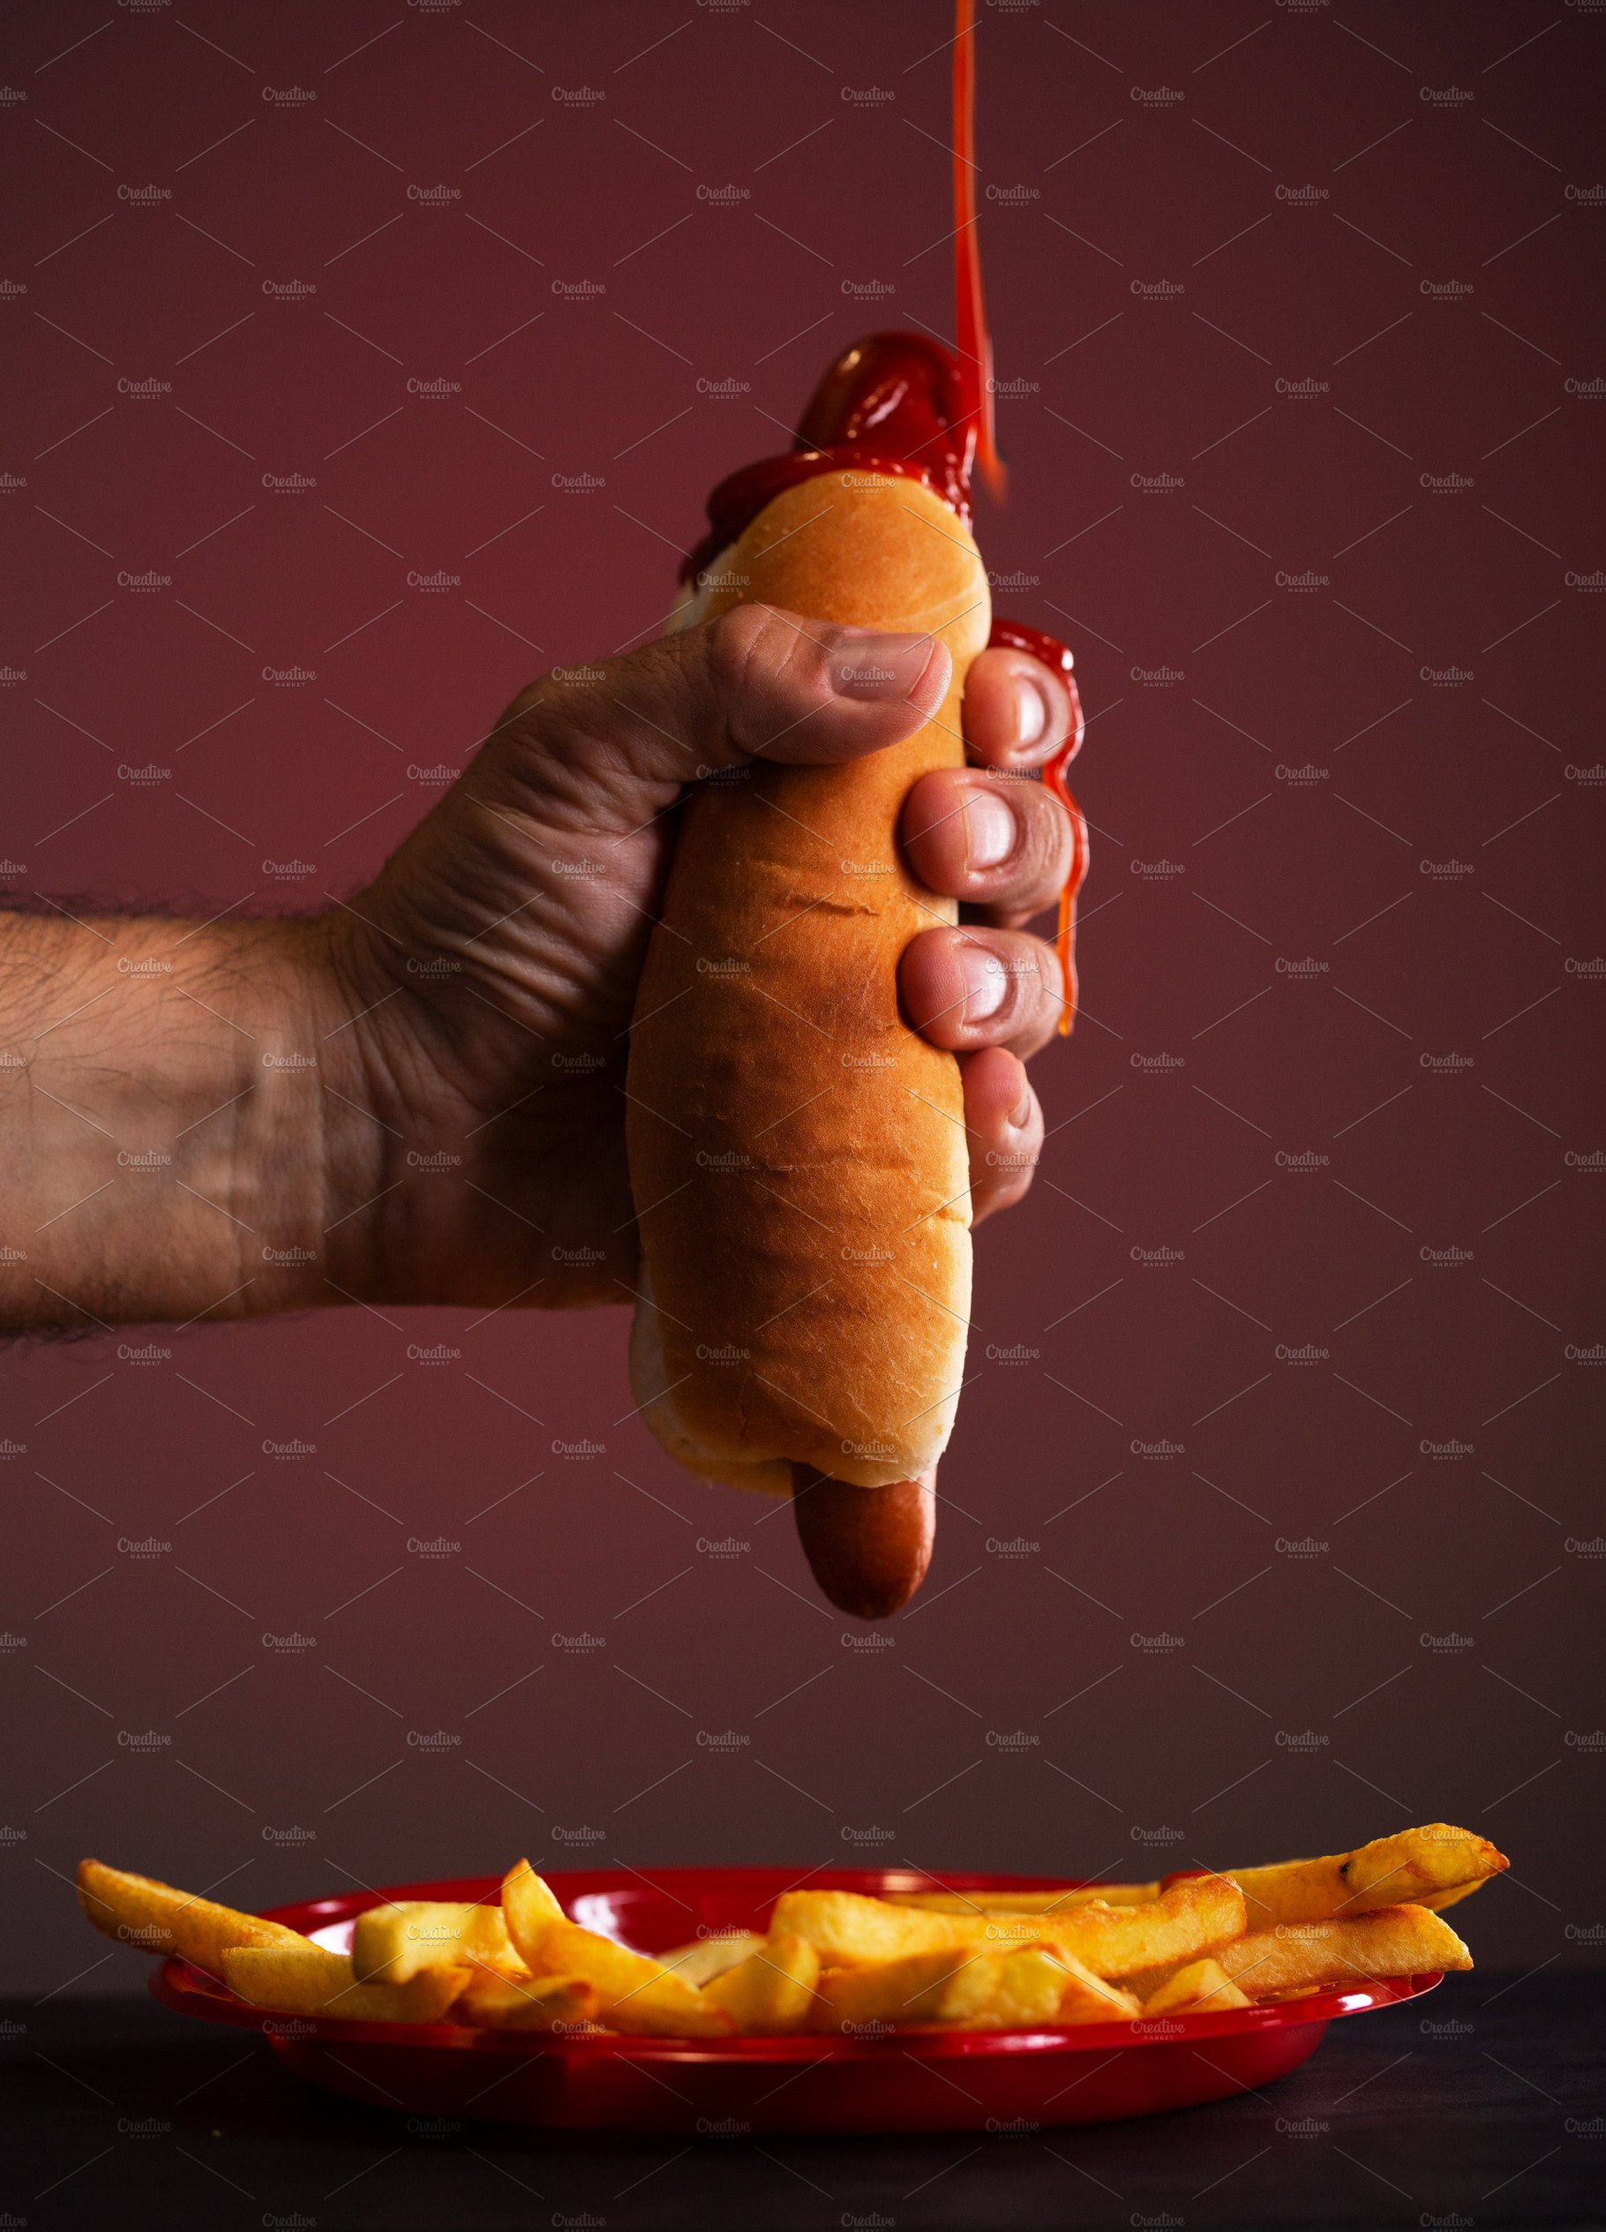

Slide 12
Commercial Two- Baseball con't
Insert catchy brand hot dog name

Slide 13
Commercial Short Three- The lush landscape of NY
Spring water- Guy drinking dirty water with "icky face"

Slide 14


Slide 15
Commercial Short Three- The lush landscape of NY (con't)
Next show clean lakes of NY -spring in backgroundand promotional New York State water bottle.

Slide 16


Slide 17

The End!

